Slide 1
Topic: Financial Maths EQ: How Do I Calculate a Percentage of An Amount?
Rule up 3 column notes!
Year 8 Mathematics
Mrs Parlevliet

Slide 2
Contents
Glossary or Formula Page
Page
Date
Essential Question
24
7
30
Word or Formula
Definition or Example

Slide 3
Tasks
24
7
30
Topic
Essential Question
Questions
Notes
Summary
1
2

Slide 4
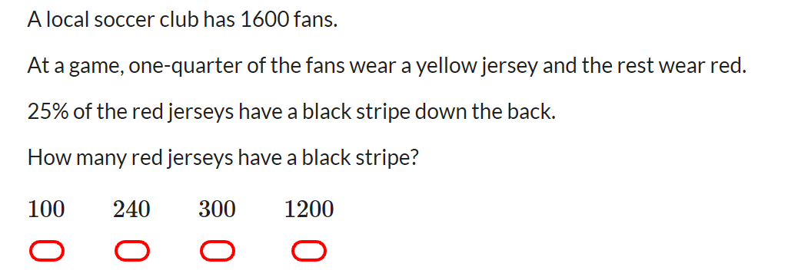
Five Questions (LHS)
Date: XX/XX/2019
Topic: Financial Maths
EQ – How do I calculate a percentage of an amount?
Draw a Venn Diagram to represent a class of 30 students there are 20 students who like Maths, 15 who like English and 12 who like both.
Name one advantage and disadvantage of a Census
Find the mean, mode, range (45, 20, 41, 38, 42, 42, 48, 55)
If Crystal knows 52% of the 25 students in her class, how many students can she name?

Slide 5
24
7
30
Topic: Financial Maths
Date: XX/XX/2019
EQ – How do I work out the percentage of an amount?
Question
Examples
Steps
How do I calculate the percentage of a number?
30% of 50
1. Express the percentage as a fraction.
(% is always out of 100)
2. Change the ‘of’ to a multiplication sign.

Slide 6
24
7
30
Financial Maths
Date: XX/XX/2019
EQ – How do I work out the percentage of an amount?
Examples
Steps
1. Express the percentage as a fraction.
(% is always out of 100)
2. Change the ‘of’ to a multiplication sign.

Slide 7


Slide 8
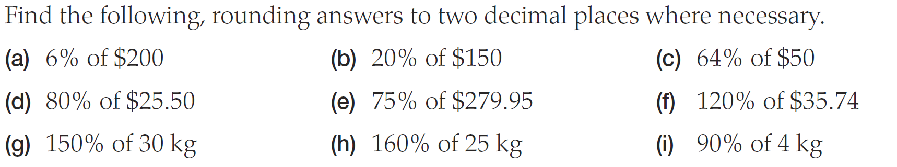
Practice

Slide 9
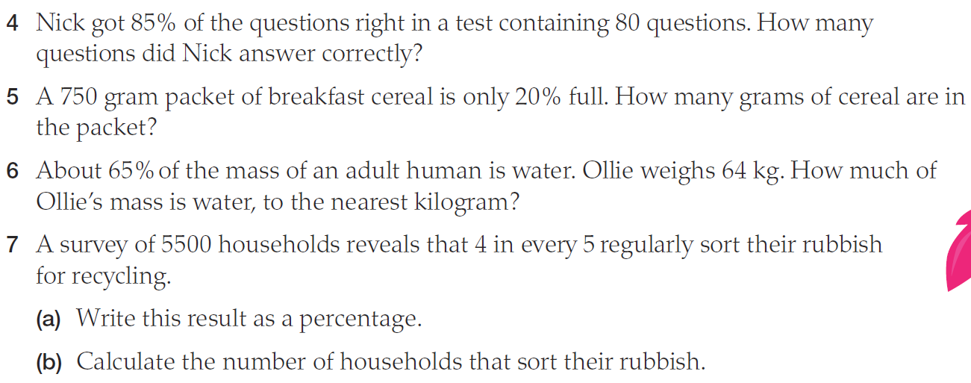
Worded Questions

Slide 10
Percentage Bingo
Aim: Full House
Grid: 9 Grid
Play: Calculate answer & cross it off

Slide 11
Use any of these numbers in your grid (NO REPEATS)
24 12 25 63
49 48 15 36
21 54 30 16
9 10 55 33

Slide 12
Question
5% of 1080

Slide 13
Question
30% of 40

Slide 14
Question
5% of 180

Slide 15
Question
90% of 40

Slide 16
Question
20% of 120

Slide 17
Question
12.5% of 200

Slide 18
Question
50% of 60

Slide 19
Question
110% of 50

Slide 20
Question
30% of 210

Slide 21
Question
150% of 10

Slide 22
Question
40% of 120

Slide 23
Question
70% of 70

Slide 24
Question
125% of 8

Slide 25
Question
10% of 160

Slide 26
Question
11% of 300

Slide 27
Question
30% of 70

